Slide 1
A Multivariate Analysis on Tanaskovi’c et al. (2012)

Slide 2
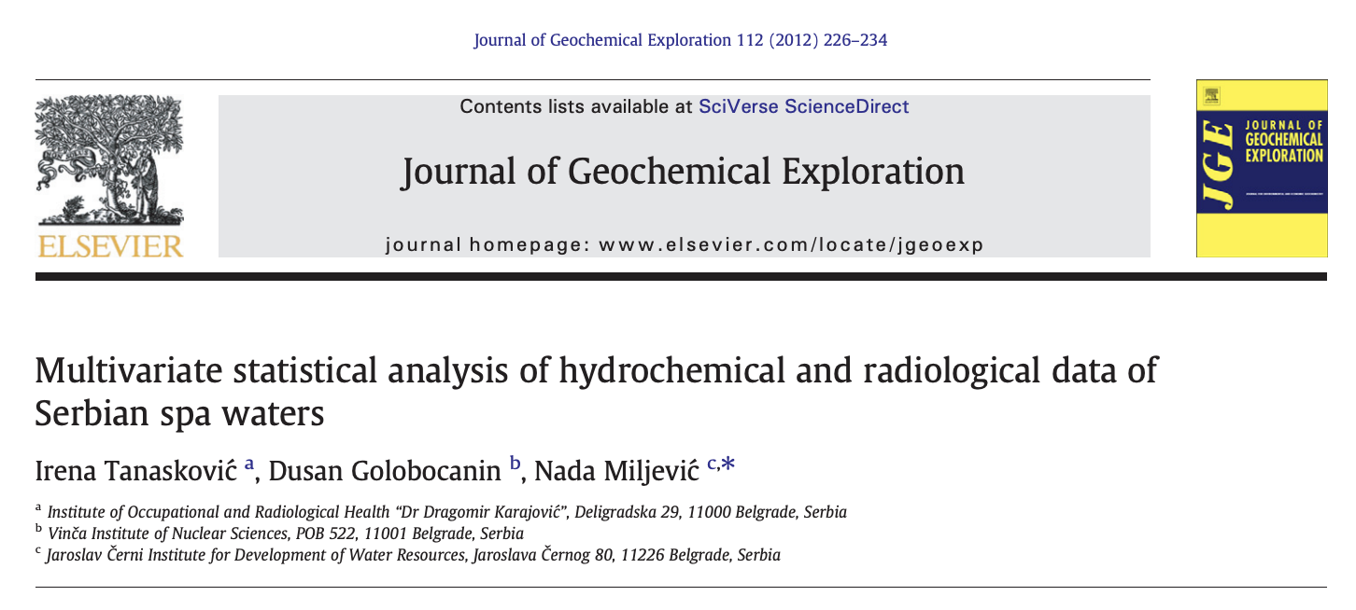

Slide 3
The Report
Sampled spa water from 30 locations across Serbia.
Measured 18 variables from 4 types of geological structure.
12 hydrochemical variables.
6 Radioactive Isotopes.
Aimed to classify and group spa waters based on hydrochemical properties, radioactive isotopes, and geological structure.
Analysed the data using Pearson correlation, PCA, and HCA.

Slide 4
Our Analysis
We aimed to answer the following questions about the hydrological data using quantitative and qualitative analysis methods.
Can you improve the paper’s results using Factor Analysis in terms of model quality with parsimony?
Are the groups identified by the dendrogram consistent with changes in the linkage and distance?

Slide 5
Samples Consistency Analysis

Slide 6
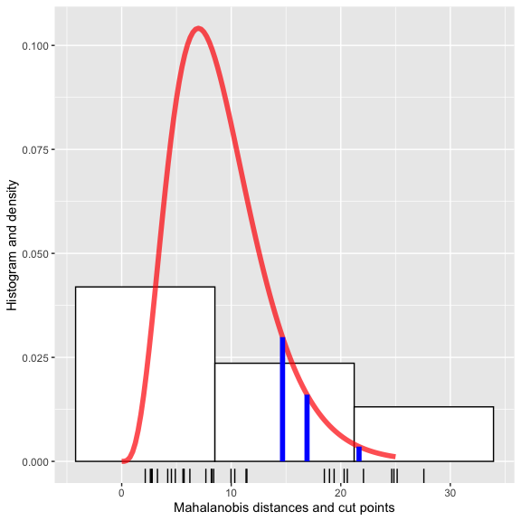
Key Findings - Mahalanobis
10 surprising observations past the first two cut points.
5 past all three.
Observations: 1, 2, 4, 15, 16, 23, 24, 28, 29 and 30.

Slide 7
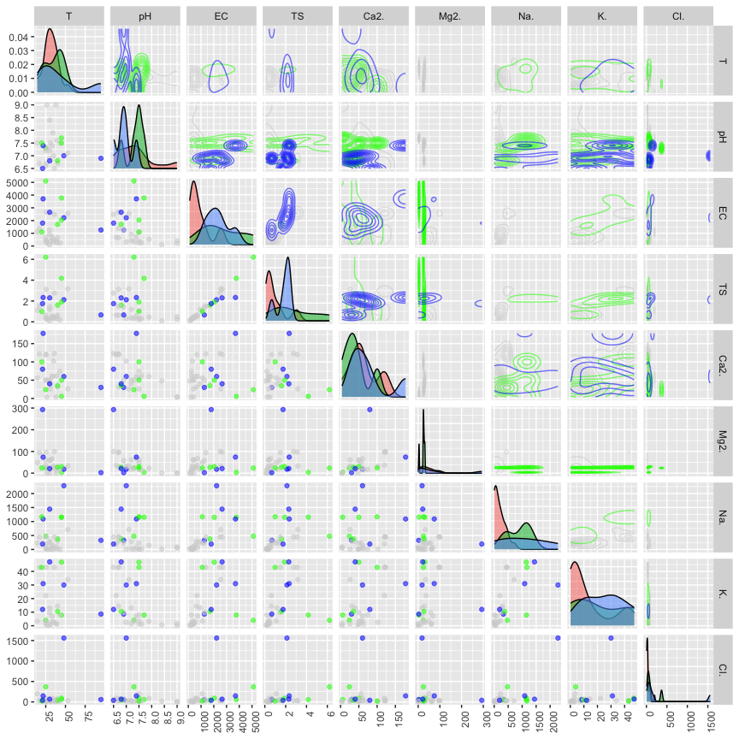
Key Findings - Pairs Plot
Strong positive relationship between EC and TS.
$Cl^{−}$ and $Mg^{2+}$ have high right-skew.
Difference in EC and TS values across surprise levels.

